Slide 1
ESA 13th ADVANCED TRAINING COURSE ON
LAND REMOTE SENSING: ❄ Snow & Glaciers
Mission Status Session introduction
Espen Volden

Slide 2

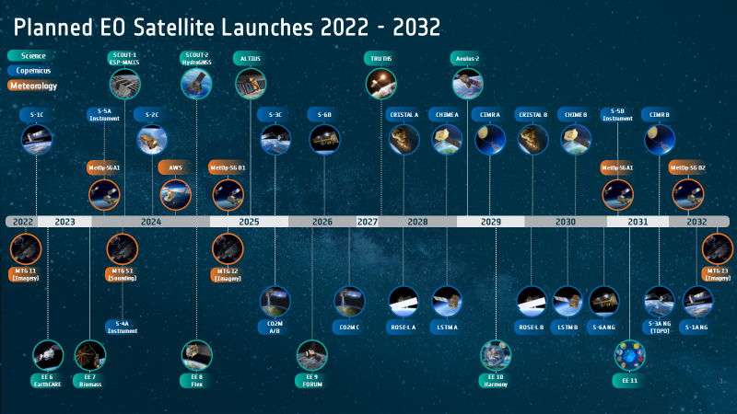



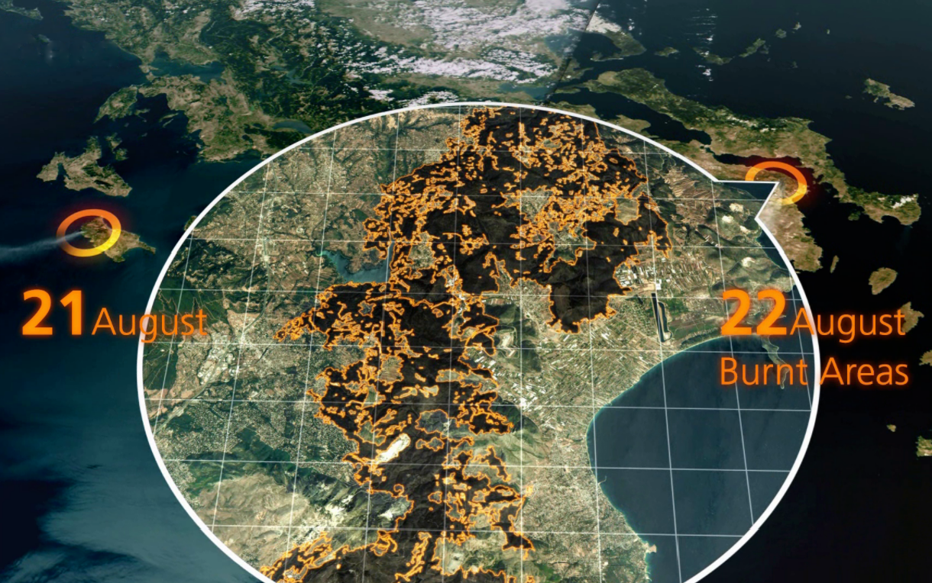



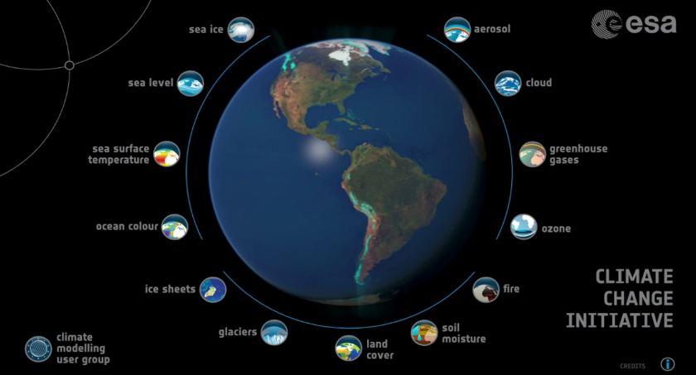

ESA EO Activities in Different Locations: ESRIN, ESTEC, ECSAT
Building satellites
Managing Missions
Cal/Val & Data Distribution
Earth System Science
Applying the Data
Innovation
Commercialisation
Emergency Response
Φ-lab
InCubed
Digital Twins
Climate Change
Accelerate the future of EO with cutting edge research
Notes:
Satellite development: Building satellites
Satellite operations: Managing missions
Data Distribution: Cal/Val & Ground segment
Applications: Science, Emergency Response, DTE, Climate Change/Space
Innovation & Commercialisation: Phi-lab & InCubed

Slide 3

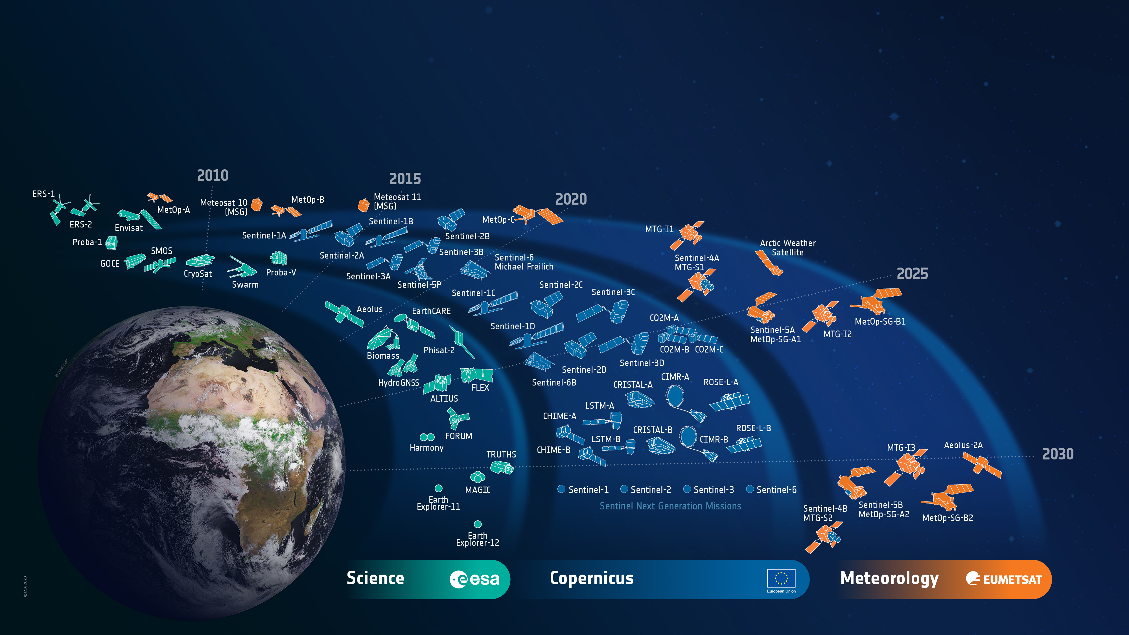

ESA’s Earth Observation Missions
Satellites
Heritage 08
Operational 12
Developing 39
Preparing 18
Total 77
World-class Earth Observation systems developed with European and global partners to address scientific & societal challenges
3
Notes:
HERITAGE MISSIONS
7 Missions/8 Satellites:
Earth Explorers+ (5M/6S)
1 GOCE
1 Aeolus
2 ERS (ERS-1/2)
1 Envisat
1 Proba-1
Earth Watch (1M/1S)
1 Proba-V
Sentinels (1M/1S)
1 Sentinel-1 (S1-B)
Met Missions (2M/8S) (EUMETSAT managed so not counted in total)
7 Meteosat (#1-7)
1 Meteosat SG (#8)
OPERATIONAL MISSIONS
8 Missions (12 satellites):
Earth Explorers+ (4M/6S)
1 SMOS
1 CryoSat
3 Swarm
1 EarthCARE
Earth Watch (0M/0S)
0
Sentinels (4M/6S)
1 Sentinel-1 (S-1A)
2 Sentinel-2 (S-2A/2B)
2 Sentinel-3 (S-3A/3B)
1 Sentinel-5P
Met Missions (3M/7S) (EUMETSAT managed so not counted in total)
3 Meteosat SG (#9-11)
1 Meteosat TG (MTG-I1)
3 MetOp (A/B/C)
MISSIONS IN DEVELOPMENT
25 Missions (39 satellites):
Earth Explorers+ (6M/7S)
1 Biomass
1 Flex
1 Forum
1 Harmony
2 Scout-2 (HydroGNSS)
1 PhiSat-2
Earth Watch (2M/2S)
1 TRUTHS
1 ALTIUS
Sentinels (12M/24S)
2 Sentinel-1 (S-1C/1D)
2 Sentinel-2 (S-2C/2D)
2 Sentinel-3 (S-3C/3D)
2 Sentinel-4 (S-4A/4B)
3 Sentinel-5 (S-5A/5B/5C)
1 Sentinel-6 (S-6B)
2 CO2M (A/B)
2 CRISTAL (A/B)
2 CIMR (A/B)
2 LST (A/B)
2 CHIME (A/B)
2 ROSE-L (A/B)
Met Missions (5M/6S)
1 Aeolus-2
1 Arctic Weather Satellite
1 Meteosat TG-I (MTG-I2)
1 Meteosat TG-S (MTG-S1)
2 MetOp SG (A1/B1)
MISSIONS IN PREPARATION
24 Missions (38 satellites):
Earth Explorers (3M/8S)
2 EE11
4 EE12
2 NGGM/MAGIC
0 SCOUT
Earth Watch (0M/0S)
0
Sentinels (5M/10S)
2 Sentinel-1 NG
(S-1NG A/B)
2 Sentinel-2 NG
(S-2NG A/B)
2 Sentinel-3 NG OPT
(S-3NGO A/B)
2 Sentinel-3 NG TOPO
(S-3NGT A/B)
2 Sentinel-6 NG
(S-6NG A/B)
Met Missions (0M/0S)
0

Slide 4
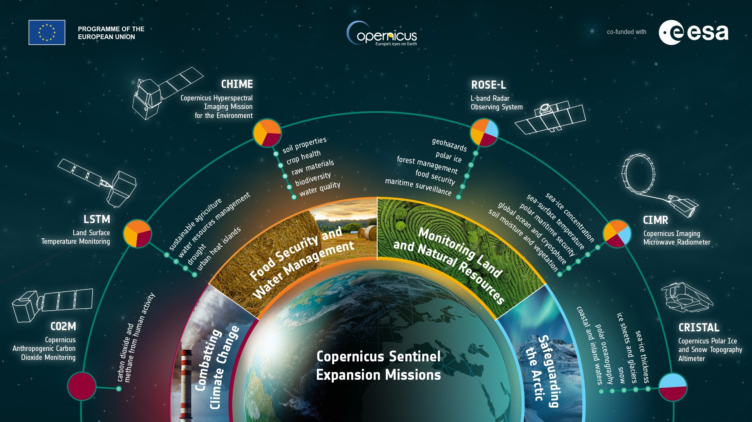
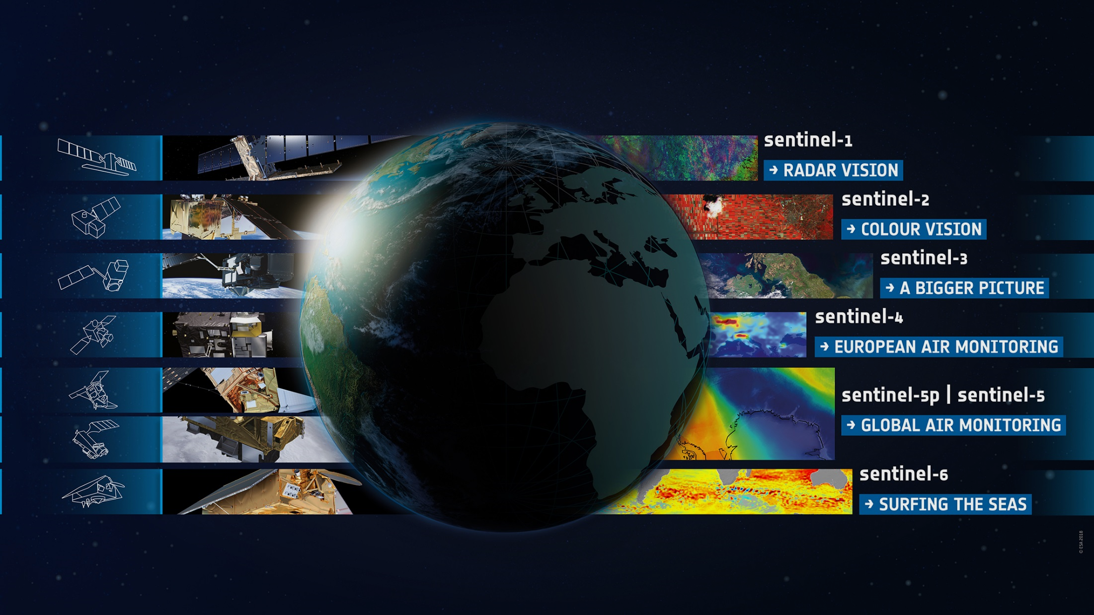

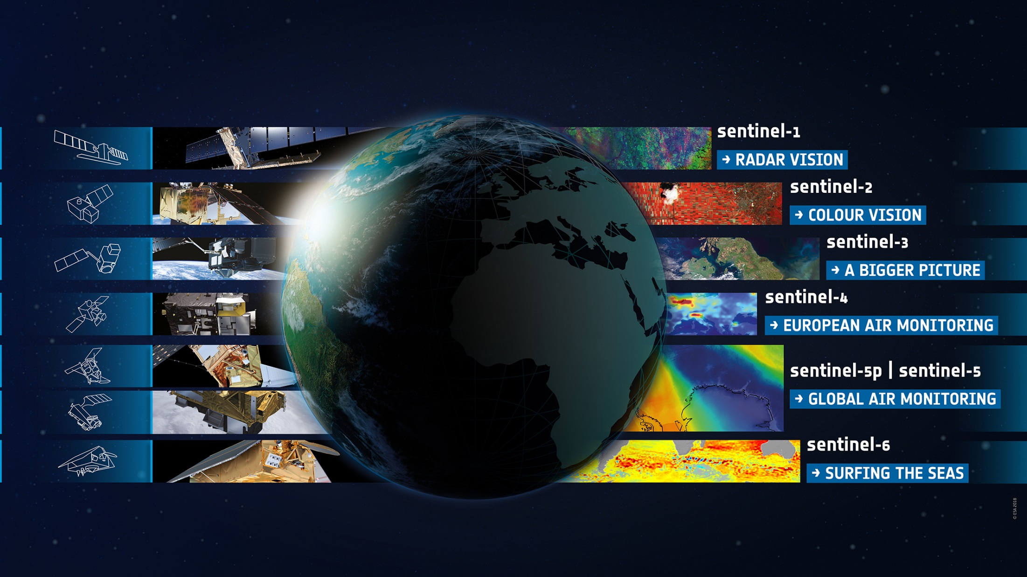
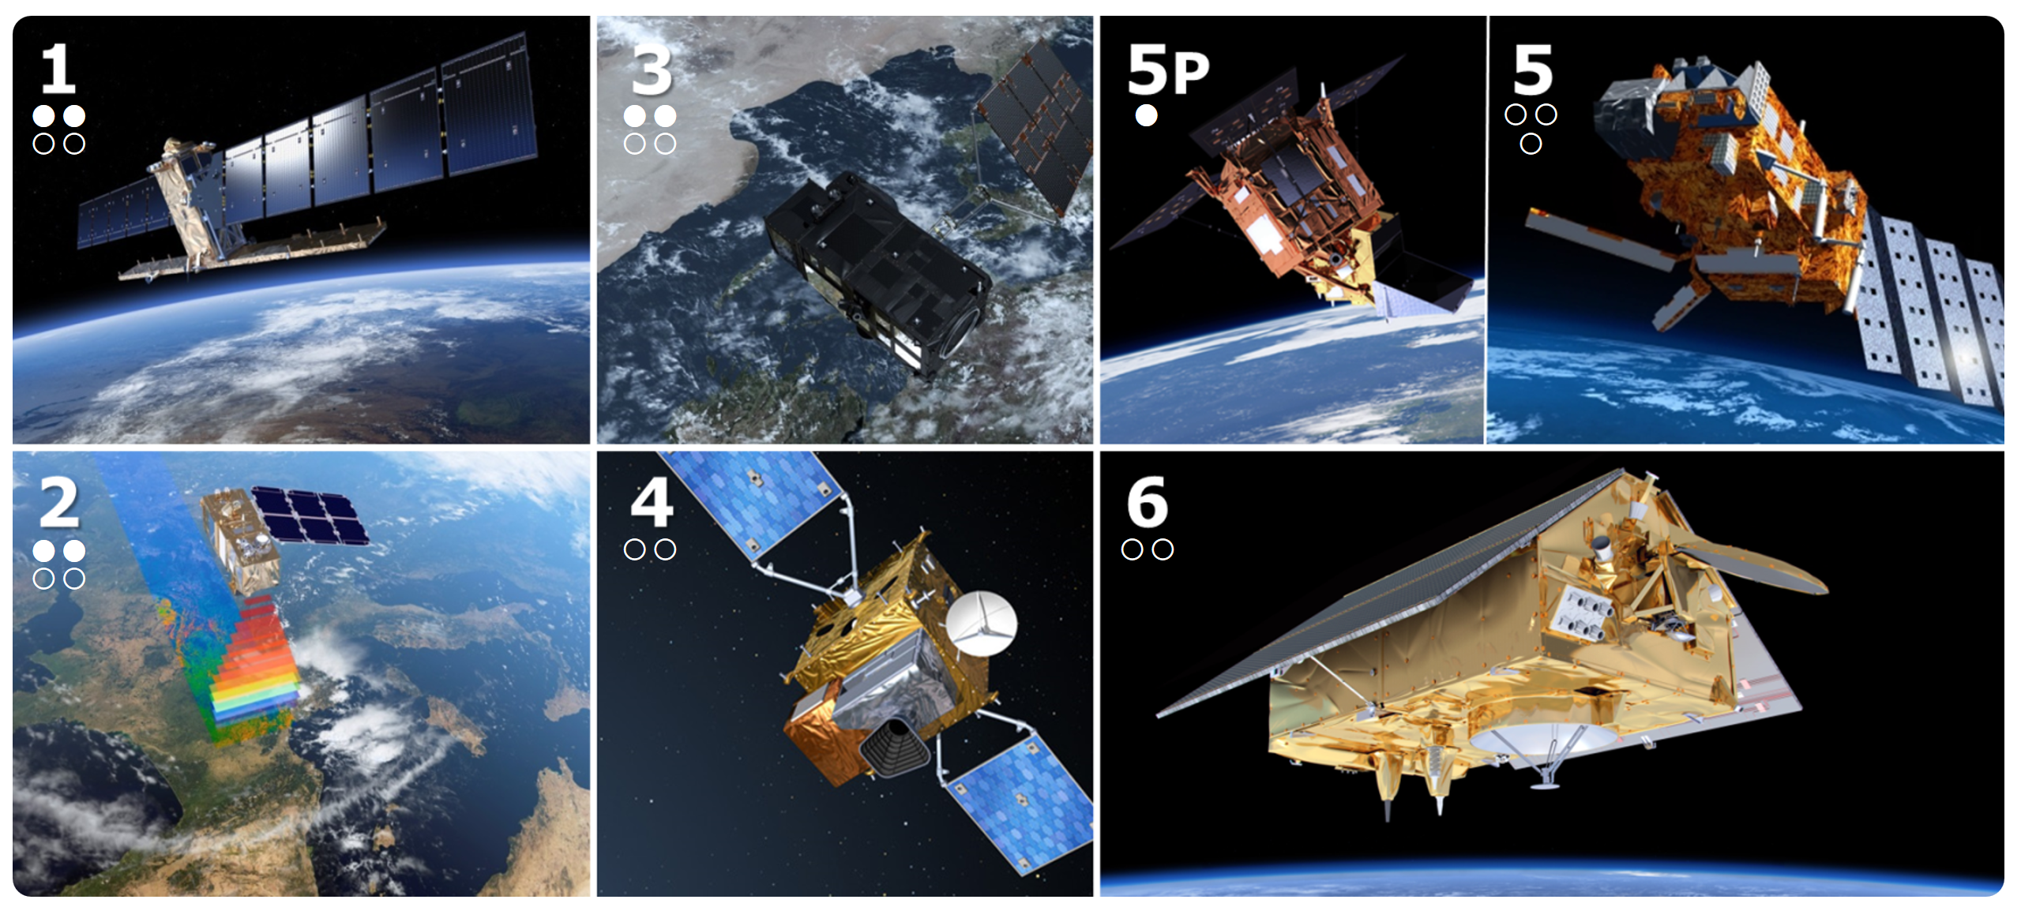
The Copernicus Sentinels
2014 / 2016
2016 / 2018
2017
2025
2015 / 2017
2024
2020
4
Notes:
ESA takes care of space component of Copernicus, having launched 8 Sentinel Satellites since 2014 of which currently 7 are still in operation.
Copernicus is the largest producer of EO data in the world providing all Sentinel data on the cloud since December 2022
Today all land masses are observed every 5 days at 10m with Sentinel 2 and every 12 days at 20m with Sentinel 1. (Was 6 days before loss of Sentinel-1B)
And those data is freely and openly available to anybody in the world,
Since December 2022, with the DAS contracts signed with the Commission, all the Sentinel data is on the cloud.
(This new Copernicus Data Access Service was successfully kicked-off on 6th December 2022. The new service will be powered by T-Systems and CloudFerro with their cloud infrastructure, Sinergise and VITO with Sentinel Hub, OpenEO data discovery and processing tools, while DLR, ACRI-ST will provide on-demand Sentinel processing and RHEA access to the Copernicus Contributing Missions data.)
+ 700.000 Registered Users, 2+ PB/week of data generated
First Generation Sentinels:
Sentinel-1 – C-band SAR imaging for All weather, day/night applications, interferometry (April 3, 2014 / April 25, 2016)
Sentinel-2 - High resolution multispectral Imaging for Land applications: urban, forest, agriculture, … Continuity of Landsat, SPOT (June 23, 2015 / March 7, 2017)
Sentinel-3 - Medium resolution multi-spectral imaging for Ocean & Global Land Monitoring Wide-swath ocean colour, vegetation, sea/land surface temperature, altimetry (February 16, 2016 / April 25, 2018)
Sentinel-4 - Geostationary Atmospheric sounding in UV, VIS and NIR, for atmospheric composition monitoring, pollution; S-4 is an instrument on MTG satellites
Sentinel-5P - precursor UV, NIR and SWIR sounder in low-Orbit for Atmospheric monitoring (October 13, 2017)
Sentinel-5 - precursor UV, NIR and SWIR sounder in low-Orbit for Atmospheric monitoring; S-5 is an instrument on MetOp-SG satellites (
Sentinel-6 – S-6A, aka Michael Freilich, Altimetry reference mission (November 21, 2020)

Slide 5


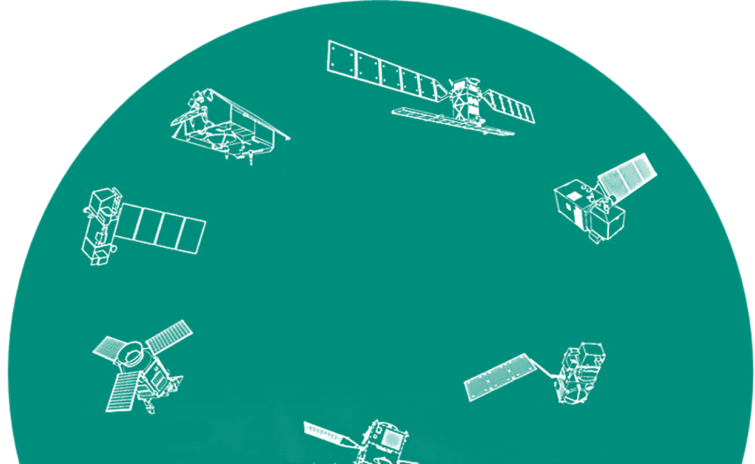
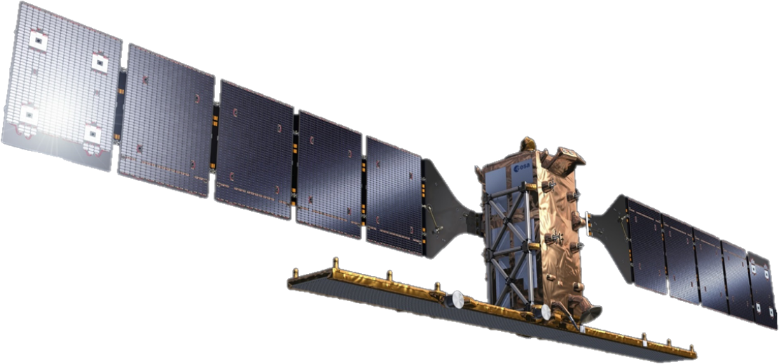
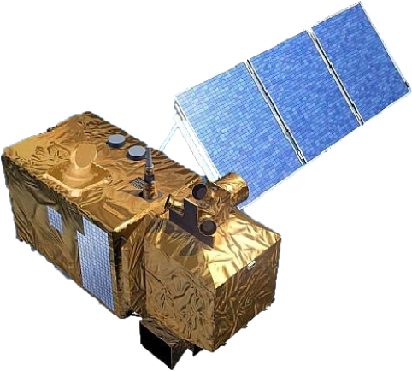
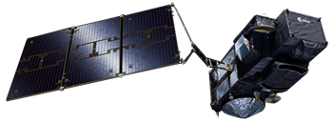
Copernicus Space Evolution
Sentinel-1 NG
Sentinel-2 NG
+ Next Generation Sentinels for data continuation and enhanced observations
Strengthening Copernicus
Space Component with
Sentinel-3
TOPO/OPT NG
5
Notes:
To guarantee data continuation and enhance the capabilities of the Copernicus Sentinels, ESA is currently developing a range of new Sentinel missions addressing climate and very importantly, food security issues, pushing further the EO capabilities by for example increasing the resolution for thermal observations by a factor 400 down to 50 meters. ESA also cooperates with the emerging New Space companies to create synergies with their innovative and often very high-resolution capabilities.
CO2M: Anthropogenic CO₂ Monitoring Climate change (causes)
CHIME: Copernicus HyperSpectral Imaging Mission for the Environment Services for food security, agriculture management, soil and mineral resources
CIMR: Copernicus Imaging Microwave Radiometer Sea surface temperature, sea ice concentration & extent, sea surface salinity, soil moisture
LSTM: Copernicus Land Surface Temperature Monitoring Thermal Infrared observations over land & coastal regions for Agriculture & Urban management services
CRISTAL: Copernicus PolaR Ice & Snow Topographic Altimeter Climate change (effects), e.g. sea-ice thickness and snow depth, surface elevation and changes of glaciers
ROSE-L: Radar Observing System for Europe L-band SAR Forests, Agriculture and high-resolution monitoring of Arctic & Cryosphere, services in Disasters & Geohazards monitoring
Beyond the expansion mission, Copernicus will also evolve into a next generation of Sentinel satellites to ensure data continuation and enhanced observations for the decades to come.
Next Generation Sentinels
Sentinel-1 NG
Sentinel-2 NG
Sentinel-3 Topo NG
Sentinel-3 Opt NG
Sentinels 1 NG and 3 TOPO have been funded at CM22

